Slide 1
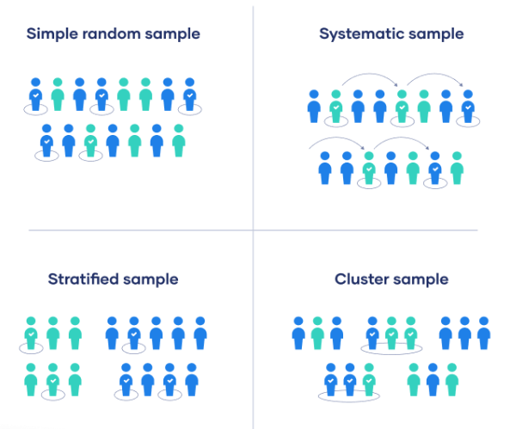
Example
All employees of the company are listed in alphabetical order. From the first 10 numbers, you randomly select a starting point: number 6. From number 6 onwards, every 10th person on the list is selected (6, 16, 26, 36, and so on), and you end up with a sample of 100 people.
Example
You want to select a simple random sample of 100 employees of Company X. You assign a number to every employee in the company database from 1 to 1000, and use a random number generator to select 100 numbers.
Equal chance of being selected
Sampling frame should include the whole population
Individuals are chosen at regular intervals
If you use this technique, it is important to make
sure that there is no hidden pattern in the list that
might skew the sample
To use this sampling method, you divide the population into subgroups (called strata) based on the relevant characteristic (e.g. gender, age range, income bracket, job role)
Cluster sampling also involves dividing the population into subgroups, but each subgroup should have similar characteristics to the whole sample.
Example
The company has 800 female employees and 200 male employees. You want to ensure that the sample reflects the gender balance of the company, so you sort the population into two strata based on gender. Then you use random sampling on each group, selecting 80 women and 20 men, which gives you a representative sample of 100 people.
Example
The company has offices in 10 cities across the country (all with roughly the same number of employees in similar roles). You don’t have the capacity to travel to every office to collect your data, so you use random sampling to select 3 offices – these are your clusters.
https://www.scribbr.com/methodology/sampling-methods/

